Slide 1


Andrew Schultz
06/24/24

Slide 2

Outline
Executive Summary
Introduction
Methodology
Results
Conclusion
Appendix

Slide 3
Executive Summary
Summary of methodologies
Data Collection using API and Web Scraping
Exploratory Data Analysis using SQL and Data Visualizations
Interactive Map using Folium
Interactive Dashboard using Plotly Dash
Predictive Analysis
Summary of all results
Exploratory Data Analysis Results
Interactive Map
Interactive Dashboard
Predictive Results

Slide 4
Introduction
Project background and context
The goal of this project is to predict if the Falcon 9 first stage will land successfully. SpaceX advertises Falcon 9 rocket launches on its website with a cost of 62 million dollars; other providers cost upward of 165 million dollars each, much of the savings is because SpaceX can reuse the first stage. Therefore, if we can determine if the first stage will land, we can determine the cost of a launch. This information can be used if an alternate company wants to bid against SpaceX for a rocket launch.
Problems you want to find answers
What are the main characteristics of a failed or successful launch?
How does each of a rocket’s variable effect whether a launch is successful or a failure?
What are the best conditions for SpaceX to achieve the best landing success?

Slide 5

Section 1

Slide 6
Methodology
Executive Summary
Data collection methodology:
SpaceX API
Web scrapping from Wikipedia
Perform data wrangling
Drop Unnecessary Columns
Convert date to a datatime datatype
Perform exploratory data analysis (EDA) using visualization and SQL
Perform interactive visual analytics using Folium and Plotly Dash
Perform predictive analysis using classification models
How to build, tune, evaluate classification models

Slide 7
Data Collection
One way datasets are collected is from SpaceX API
The information obtained by the SpaceX API includes information on the rocket, the payload, and the outcome.
Another way datasets are collected is from Web Scrapping from Wikipedia
The information obtained by Wikipedia includes information on the launches, the payload, and the outcome.
Call SpaceX API
Obtain a JSON file
Make a dataframe from JSON file
Get HTML response from Wiki
Extract data with BeautifulSoup
Make dataframe
Notes:
f

Slide 8
Data Collection – SpaceX API
1. Getting Response from API
2. Get Json File from response
spacex_url="https://api.spacexdata.com/v4/launches/past"
response = requests.get(spacex_url)
json_data = response.json()
data = pd.json_normalize(json_data)
4. Create Dictionary
launch_dict = {'FlightNumber': list(data['flight_number']),
'Date': list(data['date']),
'BoosterVersion':BoosterVersion,
'PayloadMass':PayloadMass,
'Orbit':Orbit,
'LaunchSite':LaunchSite,
'Outcome':Outcome,
'Flights':Flights,
'GridFins':GridFins,
'Reused':Reused,
'Legs':Legs,
'LandingPad':LandingPad,
'Block':Block,
'ReusedCount':ReusedCount,
'Serial':Serial,
'Longitude': Longitude,
'Latitude': Latitude}
3. Transform Data
getLaunchSite(data)
getBoosterVersion(data)
getPayloadData(data)
getCoreData(data)
5. Create and Filter Dataframe
df = pd.DataFrame(launch_dict)
data_falcon9 = df[df['BoosterVersion'] == 'Falcon 9']
6. Export Data
data_falcon9.to_csv('dataset_part_1.csv', index=False)
link

Slide 9
Data Collection - Scraping
1. Get response from Wiki
2. Obtain all tables
3. Get column names
response = requests.get(static_url)
html_tables = soup.find_all('table')
columns = first_launch_table.find_all('th')
for col in columns:
name = extract_column_from_header(col)
if (name is not None and len(name)>0):
column_names.append(name)
6. Create and export dataframe
df= pd.DataFrame({ key:pd.Series(value) for key, value in launch_dict.items() })
df.to_csv('spacex_web_scraped.csv', index=False)
4. Create dictionary
launch_dict['Flight No.'] = []
launch_dict['Launch site'] = []
launch_dict['Payload'] = []
launch_dict['Payload mass'] = []
launch_dict['Orbit'] = []
launch_dict['Customer'] = []
launch_dict['Launch outcome'] = []
# Added some new columns
launch_dict['Version Booster']=[]
launch_dict['Booster landing']=[]
launch_dict['Date']=[]
launch_dict['Time']=[]
5. Add data (See notebook for rest of code)
for table_number,table in enumerate(soup.find_all('table',"wikitable plainrowheaders collapsible")):
# get table row
for rows in table.find_all("tr"):
if rows.th:
if rows.th.string:
flight_number=rows.th.string.strip()
flag=flight_number.isdigit()
link

Slide 10
Data Wrangling
Needed to change categorical data of outcome to a binary variable: 1 means a success and 0 means a failure
1. Obtain counts and all the unique labels of outcome column
2. Define all failed outcomes
landing_outcomes = df['Outcome'].value_counts()
landing_outcomes
bad_outcomes=set(landing_outcomes.keys()[[1,3,5,6,7]])
3. Create Class column which contains the binary variable
landing_class = []
for outcome in df['Outcome']:
if outcome in bad_outcomes:
landing_class.append(0)
else:
landing_class.append(1)
landing_class
link

Slide 11
EDA with Data Visualization
Scatter Graphs: Shows relationship between variables
Flight Number vs Payload Mass
Flight Number vs Launch Site
Payload Mass vs Launch Site
Flight Number vs Orbit
Payload Mass vs Orbit
Bar Graphs: Shows relationship between categorical and numerical variables
Success Rate vs Orbit
Line Graphs: Shows variable’s trends
Success Rate vs Year
link

Slide 12
EDA with SQL
Display names of the unique launch sites
Display the first five records where launch site begins with ‘CCA’
Display total payload mass carried by those launched by NASA (CRS)
Display average payload mass carried by booster version F9 v1.1
List date of first successful landing outcome in ground pad was achieved
List names of boosters which have success in drone ship and have payload mass greater than 4000 and less than 6000
List total number of successful and failure mission outcomes
List names of booster versions which have carried the maximum payload mass
List records which display month names, failure landing outcomes in drone ships, booster versions, and launch site for those in the year 2015
Rank count of landing outcomes between the dates 2010-06-04 and 2017-03-20, in descending order
link

Slide 13
Build an Interactive Map with Folium
Folium Map object is centered on NASA Johnson Space Center
Red circle at NASA Johnson Space Center’s coordinates with label
Red circles at each launch site coordinates with labels
Clustering points to display diverse and multiple pieces of information for the same coordinates.
Markers to show successful and unsuccessful launches
Green = Successful and Red = Unsuccessful
Markers and lines to show distance between launch sites and key locations
This map is designed to enhance understanding of the problem and the data. It displays all launch sites, their surroundings, and the number of successful and unsuccessful launches.
link

Slide 14
Build a Dashboard with Plotly Dash
The dashboard contains a dropdown menu, a pie chart, a scatter plot, and a range slider
Dropdown allows users to change launch site
Pie chart shows total success and failures of the specified launch site
Range slider allows for the user to change payload max in a fixed range
Scatter plot shows the relationship between the success and payload mass
link

Slide 15
Predictive Analysis (Classification)
1. Data Preparation
2. Model Training
Load and Normalize data. Split data into training and testing sets.
Selection of Machine Learning Algorithm
Set parameters for GridSearchCV
Train GridSearchCV model with training sets
3. Model Evaluation
4. Model Comparison
Obtain best hyperparameters
Calculate accuracy of model with testing sets
Plot Confusion Matrix
Comparison models based on accuracy and choose the model with the best accuracy
link

Slide 16
Results
Exploratory data analysis results
Interactive analytics demo in screenshots
Predictive analysis results

Slide 17

Section 2

Slide 18
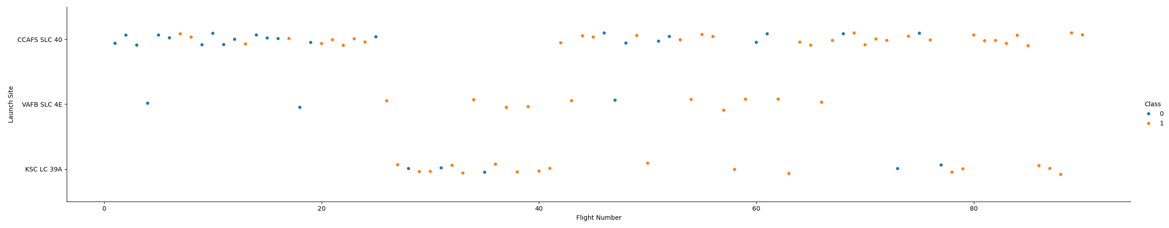
Flight Number vs. Launch Site
It is observed that KSC and VAFB launch sites have similar number of successes.

Slide 19
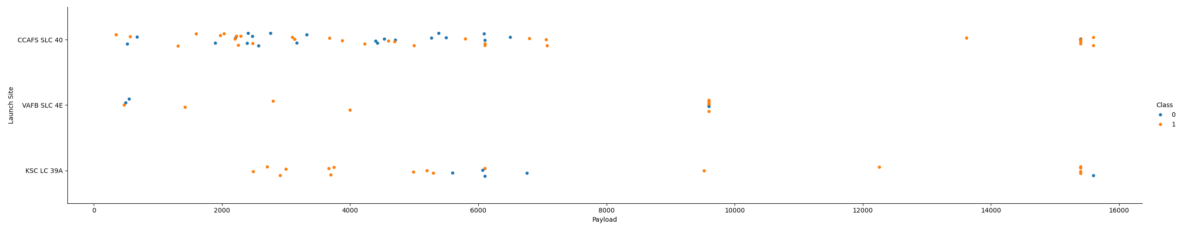
Payload vs. Launch Site
For all launch sites, it is observed that the number of successful launches increases with heavier payload masses. At the KSC launch site, there are also quite a few successes within the 2000-4000 kg payload range

Slide 20
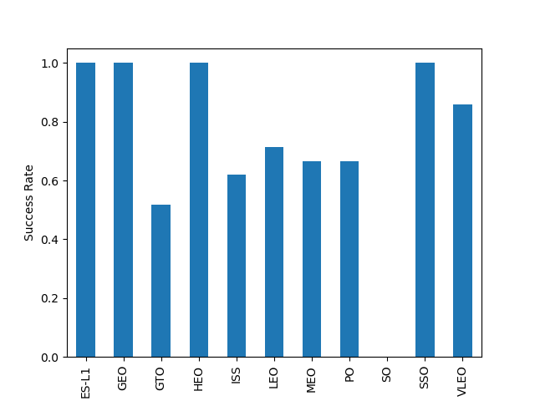
Success Rate vs. Orbit Type
The ESL, GEO, HEO, SSO orbit types have 100 percent success rate, while the orbit type of SO as zero percent success rate

Slide 21
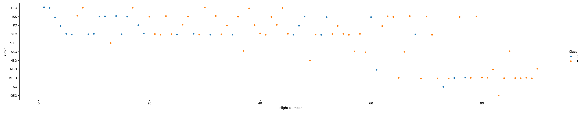
Flight Number vs. Orbit Type
It is observed that those orbit types with 100 percent and zero percent success rates have small sample sizes.

Slide 22
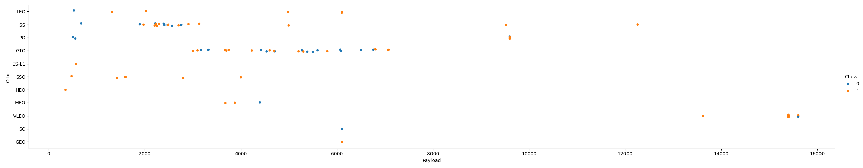
Payload vs. Orbit Type
Payload mass significantly impacts certain orbit types. Specifically, ES-L1, SSO, and HEO orbits show higher success rates with smaller payload masses, while PO, LEO, and VLEO orbits tend to be more successful with larger payload masses.

Slide 23
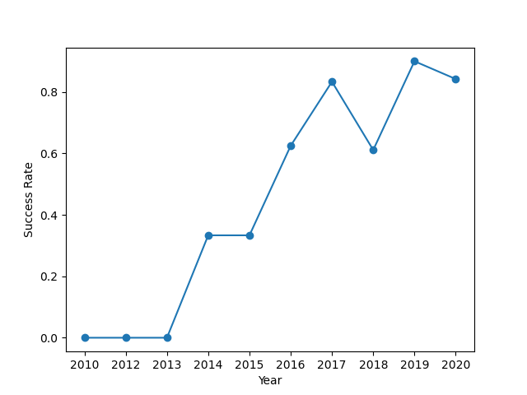
Launch Success Yearly Trend
It can be observed that as the years have gone on the success rate has increased; however, it is also observed that there was a slight decrease success rate in 2018.

Slide 24
All Launch Site Names
%sql SELECT DISTINCT Launch_Site FROM SPACEXTBL
Result: CCAFS LC-40, VAFB SLC-4E, KSC LC-39A, and CCAFS SLC-40
Using the keyword distinct removes all duplicate values for Launch_Site

Slide 25
Launch Site Names Begin with 'CCA'
%sql SELECT * FROM SPACEXTBL WHERE “LAUNCH_SITE” LIKE ‘CCA%’
Date | Time (UTC) | Booster_Version | Launch_Site | Payload | PAYLOAD_MASS__KG_ | Orbit | Customer | Mission_Outcome | Landing_Outcome
2010-06-04 | 18:45:00 | F9 v1.0 B0003 | CCAFS LC-40 | Dragon Spacecraft Qualification Unit | 0 | LEO | SpaceX | Success | Failure (parachute)
2010-12-08 | 15:43:00 | F9 v1.0 B0004 | CCAFS LC-40 | Dragon demo flight C1, two CubeSats, barrel of Brouere cheese | 0 | LEO (ISS) | NASA (COTS) NRO | Success | Failure (parachute)
2012-05-22 | 7:44:00 | F9 v1.0 B0005 | CCAFS LC-40 | Dragon demo flight C2 | 525 | LEO (ISS) | NASA (COTS) | Success | No attempt
2012-10-08 | 0:35:00 | F9 v1.0 B0006 | CCAFS LC-40 | SpaceX CRS-1 | 500 | LEO (ISS) | NASA (CRS) | Success | No attempt
2013-03-01 | 15:10:00 | F9 v1.0 B0007 | CCAFS LC-40 | SpaceX CRS-2 | 677 | LEO (ISS) | NASA (CRS) | Success | No attempt
Using the keyword and like allows us to find only the rows where launch_site starts with CCA

Slide 26
Total Payload Mass
%sql SELECT SUM(PAYLOAD_MASS__KG_) FROM SPACEXTBL WHERE “CUSTOMER” LIKE ‘NASA (CRS)’;
Result: 45,596 kg
Using the SUM keyword allows us to add up the value of PAYLOAD_MASS__KG_ where customer is NASA (CRS)

Slide 27
Average Payload Mass by F9 v1.1
%sql SELECT AVG(PAYLOAD_MASS__KG_) FROM SPACEXTBL WHERE “BOOSTER_VERSION” LIKE ‘%F9 v1.1%’;
Result: 2534.67 kg
By using the keyword AVG allows us to find the mean value for PAYLOAD_MASS__KG_ for all the rows where the Booster Version is F9 v1.1

Slide 28
First Successful Ground Landing Date
%sql SELECT MIN(DATE), Landing_Outcome as Outcome, FROM SPACEXTBL WHERE Outcome like ‘%Success (ground pad)%’;
Result: 2015-12-22
By using the keyword MIN could find the first successful landing where the outcome is Success (ground pad)

Slide 29
Successful Drone Ship Landing with Payload between 4000 and 6000
%sql SELECT Booster_Version, Landing_Outcome as Outcome, PAYLOAD_MASS__KG_ FROM SPACEXTBL WHERE Outcome like ‘%Success (drone ship)%’ AND CAST(PAYLOAD_MASS__KG_ AS FLOAT) > 4000 AND CAST(PAYLOAD_MASS__KG_ AS FLOAT) < 6000;
Result: F9 FT B1022, F9 FT B1026, F9 FT B1021.2, F9 FT B1031.2
By using the keyword AND are able to query multiple things into one query

Slide 30
Total Number of Successful and Failure Mission Outcomes
%sql SELECT (SELECT COUNT(MISSION_OUTCOME) FROM SPACEXTBL WHERE “MISSION_OUTCOME” LIKE ‘%Success%’) AS SUCCESS,
(SELECT COUNT(MISSION_OUTCOME) FROM SPACEXTBL WHERE “MISSION_OUTCOME” LIKE ‘%Failure%’) AS FAILURE;
Result:
Success: 100
Failure: 1
Retrieves the counts of mission outcomes labeled as 'Success' and 'Failure' from the table SPACEXTBL and presents them as columns named SUCCESS and FAILURE, respectively.

Slide 31
Boosters Carried Maximum Payload
%sql SELECT DISTINCT BOOSTER_VERSION FROM SPACEXTBL WHERE “PAYLOAD_MASS__KG_” = (SELECT MAX(PAYLOAD_MASS__KG_) FROM SPACEXTBL)
Result:
Booster_Version
F9 B5 B1048.4
F9 B5 B1049.4
F9 B5 B1051.3
F9 B5 B1056.4
F9 B5 B1048.5
F9 B5 B1051.4
F9 B5 B1049.5
F9 B5 B1060.2
F9 B5 B1058.3
F9 B5 B1051.6
F9 B5 B1060.3
F9 B5 B1049.7
Retrieves unique booster versions from the table SPACEXTBL where the payload mass is equal to the maximum payload mass using a subquery.

Slide 32
2015 Launch Records
%sql SELECT substr(DATE, 6, 2) AS MONTH, Booster_Version, Launch_Site, Landing_Outcome as Outcome, DATE AS dt FROM SPACEXTBL
WHERE Outcome like ‘Failure (drone ship)’ AND substr(dt, 0, 5) == ‘2015’;
Result:
MONTH | Booster_Version | Launch_Site | Outcome | dt
01 | F9 v1.1 B1012 | CCAFS LC-40 | Failure (drone ship) | 2015-01-10
04 | F9 v1.1 B1015 | CCAFS LC-40 | Failure (drone ship) | 2015-04-14
By using the keyword substr can find the month and year of a date to find the month and booster version of a launch from the year 2015 and resulted in a drone ship failure.

Slide 33
%sql SELECT COUNT(Landing_Outcome), Landing_Outcome as Outcome FROM SPACEXTBL WHERE DATE >= '2010-06-04' AND DATE <= '2017-03-20' AND Outcome like '%Success%' GROUP BY Outcome ORDER BY COUNT(Outcome) DESC;
Rank Landing Outcomes Between 2010-06-04 and 2017-03-20
%sql SELECT COUNT(Landing_Outcome), Landing_Outcome as Outcome FROM SPACEXTBL
WHERE DATE >= ‘2010-06-04’ AND DATE <= ‘2017-03-20’ AND Outcome LIKE ‘%Success%’
GROUP BY Outcome ORDER BY COUNT(Outcome) DESC;
Result:
COUNT(Landing_Outcome) | Outcome
5 | Success (drone ship)
3 | Success (ground pad)
Use the keywords group by and order by to find the ranking of the counts of successful launches between the dates 2010-06-04 and 2017-03-20.

Slide 34

Section 3

Slide 35
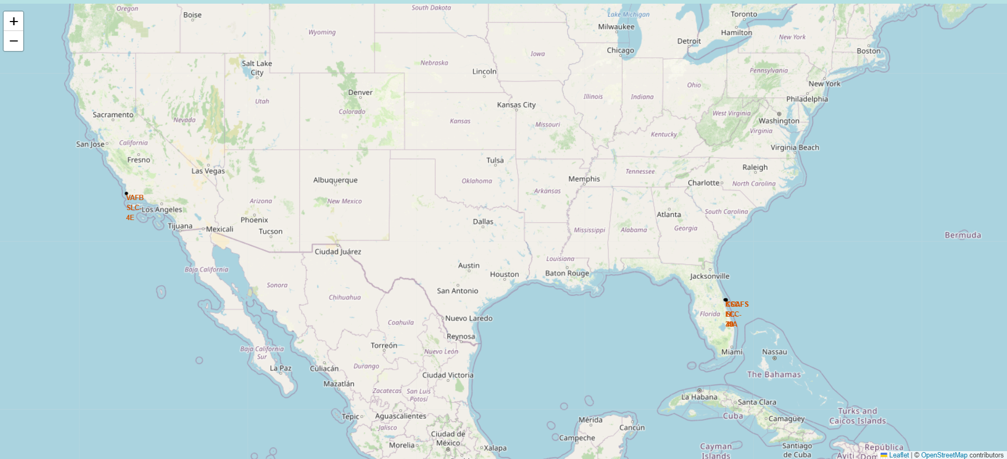
Folium Map- Base Launch Sites
One can observe that the SpaceX launch sites are either in California or Florida

Slide 36

Folium Map- Colored Labeled Markers
Green Marker represents a successful launch. Red Marker represents a failed launch

Slide 37
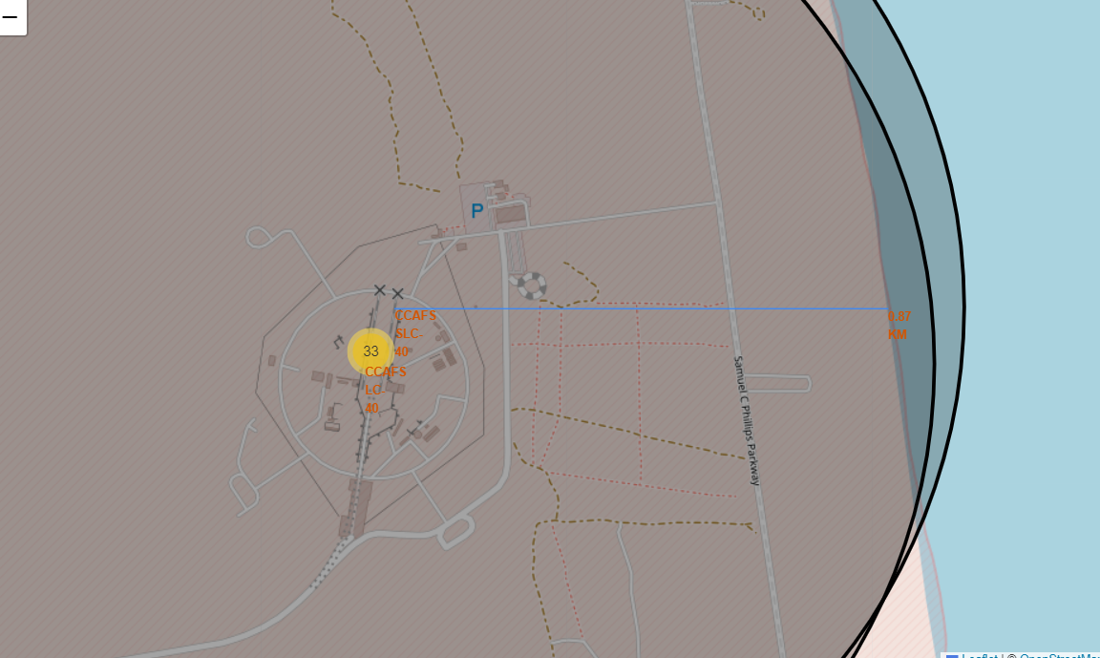
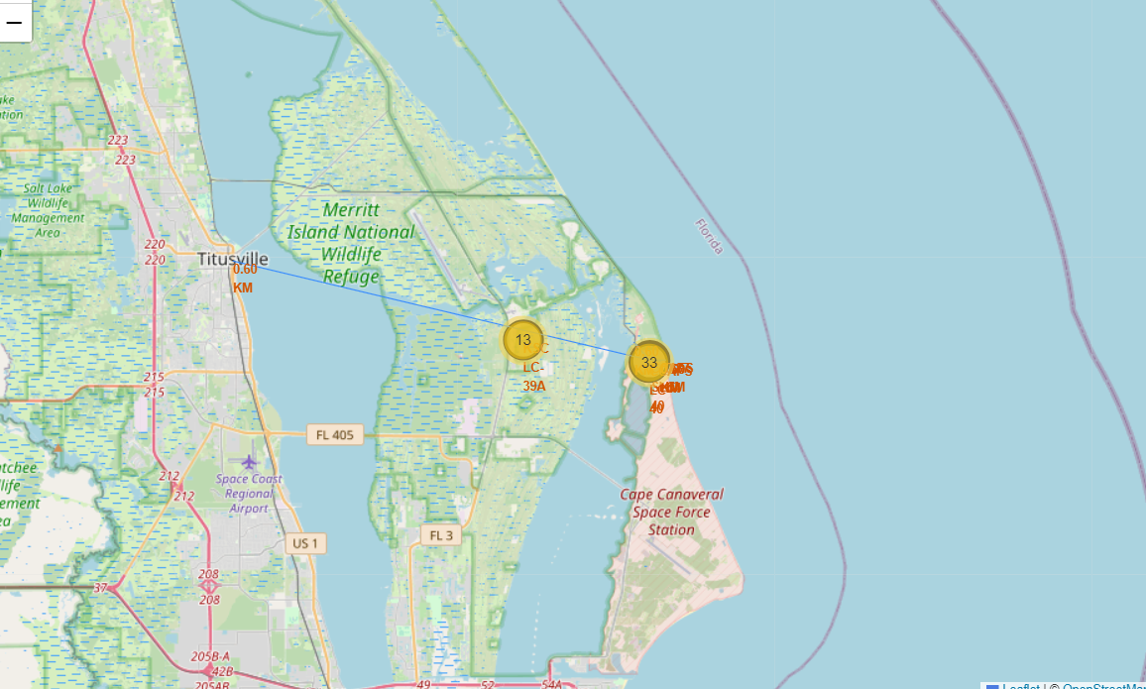
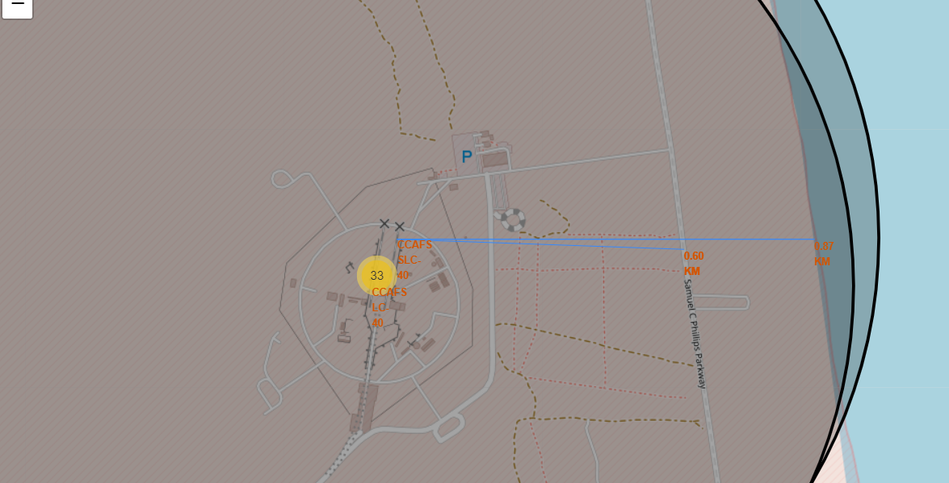
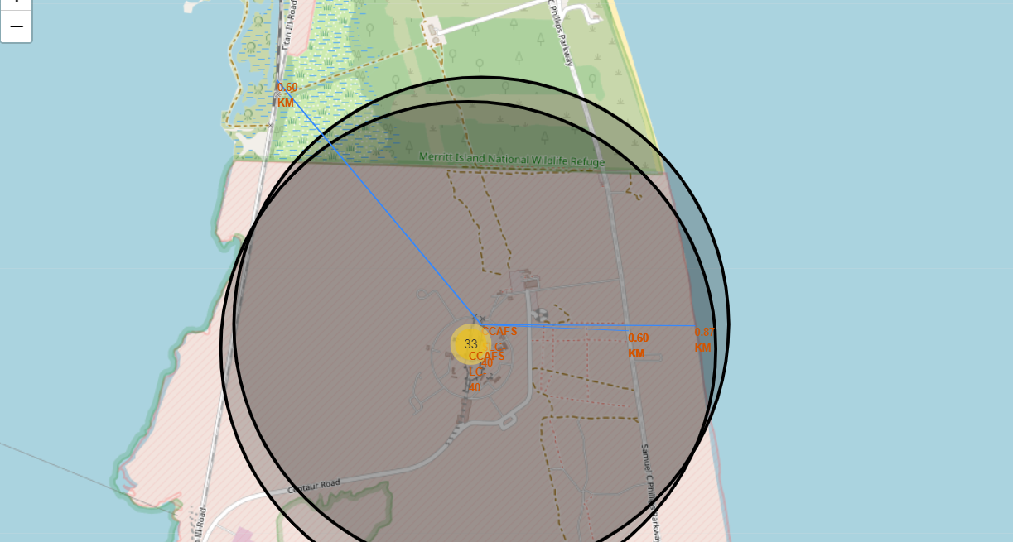
Folium Map- CCAFS SLC-40 and its Proximities
Are launch sites in close proximity to railways? Yes
Are launch sites in close proximity to highways? Yes
Are launch sites in close proximity to coastline? Yes
Do launch sites keep certain distance from cities? No

Slide 38

Section 4

Slide 39
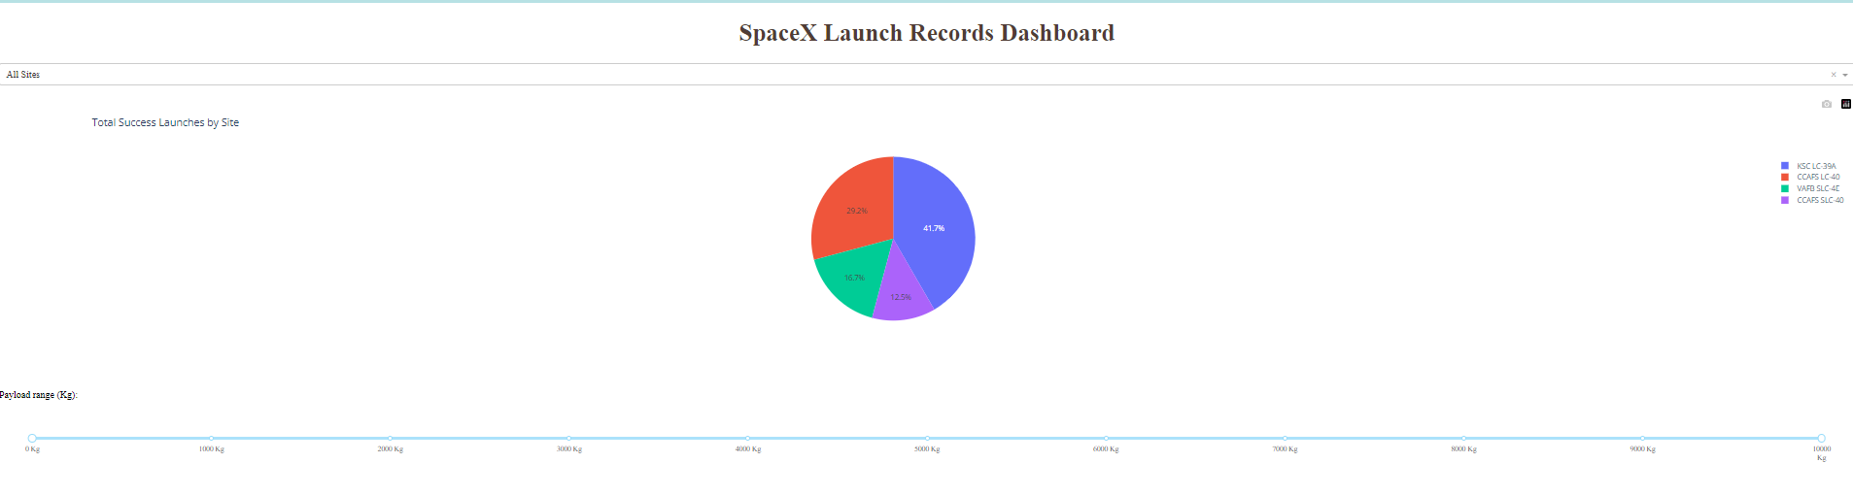
Dashboard- Total Successes By Site
It is observed that KSC has the most successful launches.

Slide 40
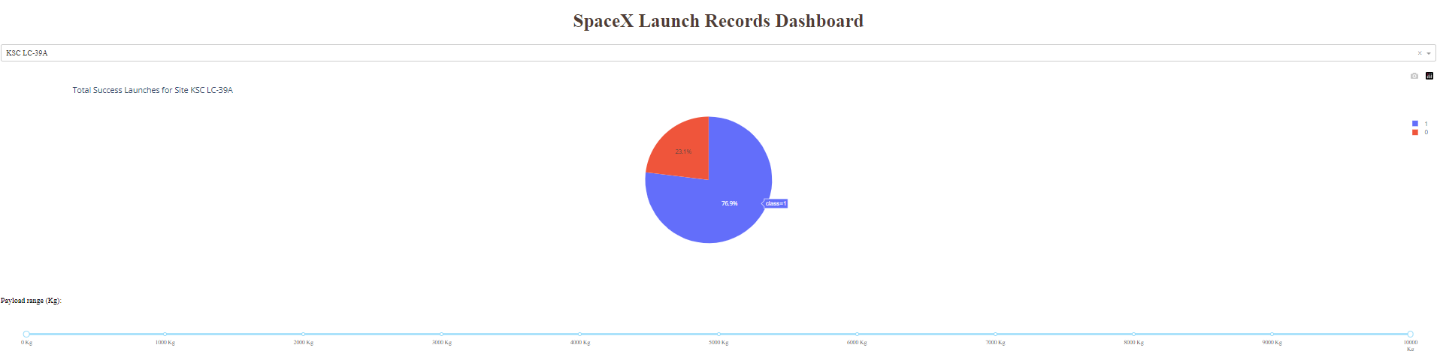
Dashboard- Success Percentage of KSC
It is observed that KSC has a success rate of 76.9%.

Slide 41
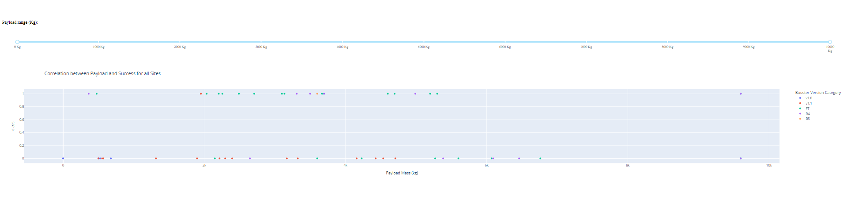
Dashboard- Success Rate of Payload Mass for All
It is observed that the highest success rates where mainly those in the 2000-4000 kg range.

Slide 42

Section 5

Slide 43
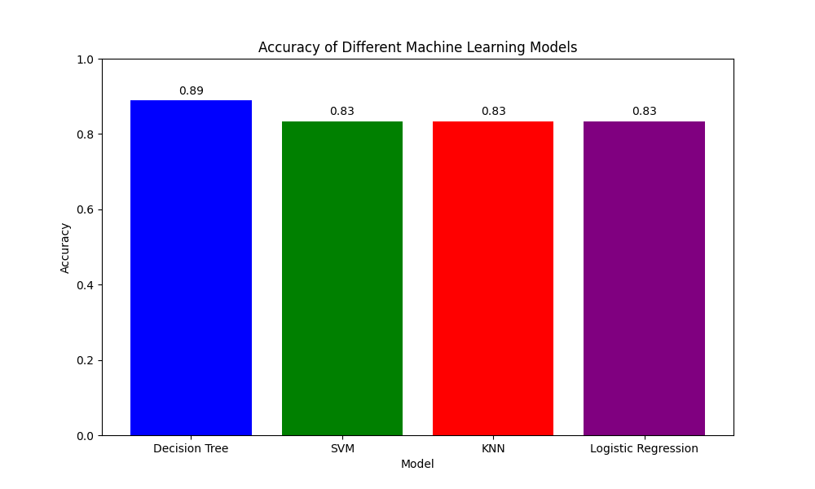
Classification Accuracy
The models are pretty much the same accuracy; however, the accuracy of the decision tree model is the best

Slide 44
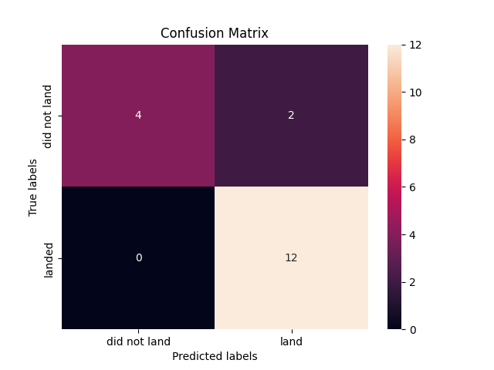
Confusion Matrix
The model has a good accuracy; however, there are two false positive results.

Slide 45
Conclusions
Landing outcome can be influenced by multiple factors such as launch site, orbit, and payload mass.
Orbits that have the most successful landings are: GEO, HEO, SSO, ES-L1
The payload mass significantly influences the outcome of a landing depending on the orbit, with some orbits requiring higher or lower payload mass for successful landings.
The Decision Tree Model is the best at predicting the correct landing outcome.

Slide 46


